Slide 1
INFO2000 Elaboration Phase UP SDLC Core Process 3 cont.
Susan Benvenuti
Friday, 26 February 2016
FNB113

Slide 2
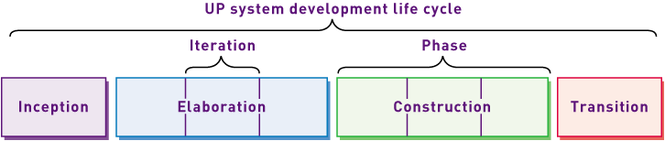
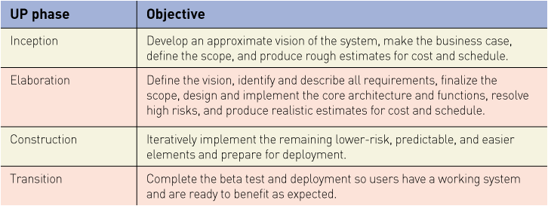
Recap…
Elaboration Phase of UP SDLC
Core Process 3 (Chapter 2 – 5 – both editions)

Slide 3
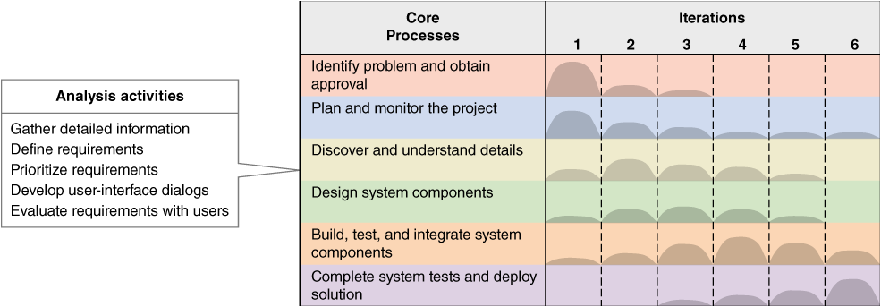
Core Process 3: Discover and Understand Details

Slide 4
Core Process 3: Discover and Understand Details
Analysis Phase
Requirements Discovery or Elicitation
Understanding WHAT the system must do in order to
solve the business problem
or enable the opportunity
or meet the directive

Slide 5
Analysis Plan
What information do we have/need relating to requirements?
What are the best ways of gathering / verifying the requirements?
Which methods/techniques/approaches?
Who/what are the best sources
Which stakeholders/users ?
Which processes?
Which documents/data?

Slide 6
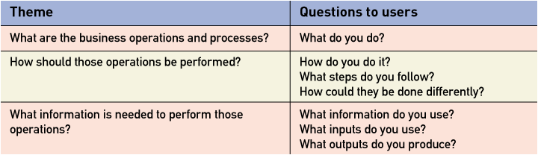
For all approaches consider:

Slide 7
Workflow example
Patient wants to book appointment
Receptionist needs to check whether patient is new or existing
If new then need to get :
Personal and contact details
Medical aid details
Brief medical history
Ask patient for preferred appointment date and time
if available book
If not then offer alternative
Otherwise ask patient for another possible appointment date and time

Slide 8
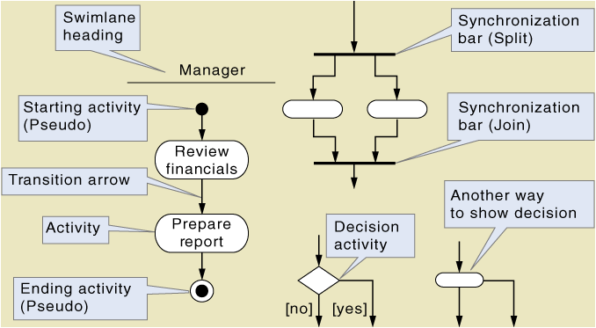
Activity Diagram Symbols

Slide 9
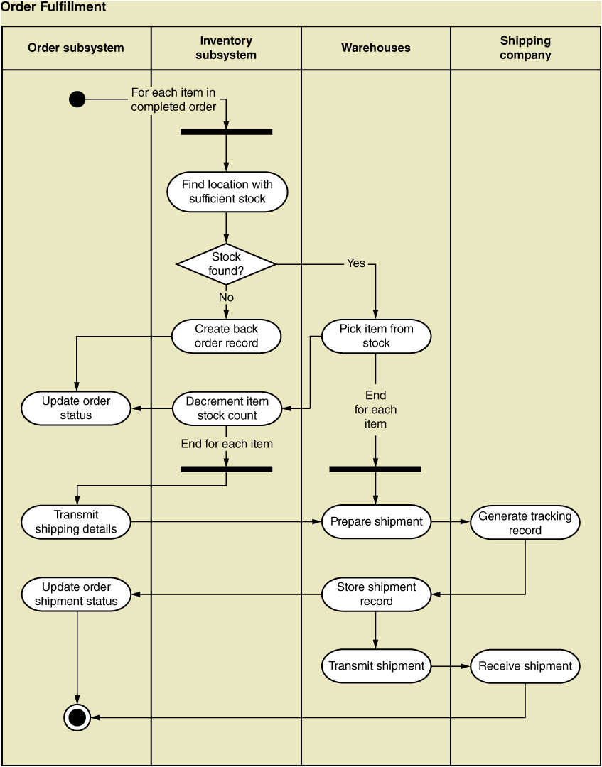

Slide 10
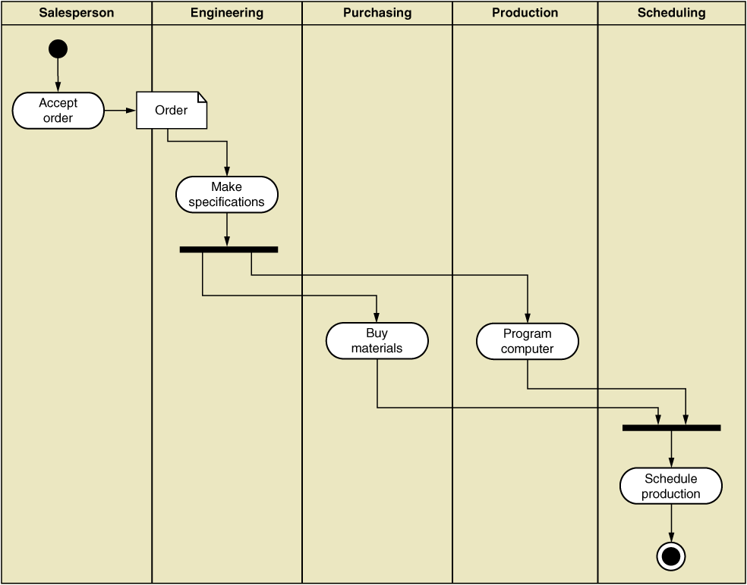

Slide 11
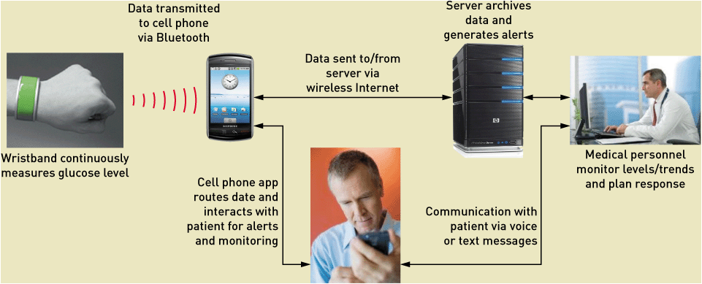

Slide 12
Users, User Stories and Use Cases
Goal is to identify users/stakeholders and understand their needs

Slide 13
User Stories
One short sentence in the everyday language of the end user that states what a user might do as part of their work
Standard Template:
As a <role played> I want/need to <goal or desire> so that <reason or benefit>
Acceptance Criteria:
The features that must/should be present for the user to be satisfied
User stories help analysts to identify and define (elaborate on) Use Cases

Slide 14
Use Cases
An activity that the system performs in response to a request by a user
“one case of usage” of the system …
User Goal Technique
Identify all potential users of a system
Classify potential users by
Functional role(s)
Organisational Levels – operations / management / executive
Interview to discover User Stories / Goals
Create set of Preliminary Use Cases
Review for similarities and overlaps of functionality
Identify where users need similar use cases
Review with each type of user and general stakeholders

